Slide 1
Capstone Presentation
Name: Tang Ka Kit
Contact: tangjay58@gmail.com
Link: https://github.com/jaytang0508/Coursera_Capstone/blob/master/Cousera_Capstone%20(3).ipynb

Slide 2
Table of Content
Introduction
Data Acquitsition
Methodology
Result
What can be done further?
Conclusion

Slide 3
Introduction
Target: compares the consumer behaviours among income groups in New York City (NYC)
Method: observing the citizens’ favourite types of venues
Beneficiaries: Entrepreneurs
-------------------------------------------------------------------------------------
At the end, you will know:
What kind of business should we establish?
Which income group should we target?
Simple program designed for letting you know which exact neighborhoods to set up the business

Slide 4
Data
Median Income of the neighborhoods in NYC
- https://www.renthop.com/study/assets/new-york-city-cost-of-living-2017/nyc-2br-median-rent-and-income-table.html
Longitude & Latitude data of the neighborhoods in NYC
- https://geo.nyu.edu/catalog/nyu_2451_34572
Common Venue data of the neighborhoods in NYC
- Foursquare

Slide 5
Methodology
Divided into 4 parts…
Import and Clean data
Explore the Neighborhood
Analyze the relationship between income group and common venues
Create a tool to display where the venues are famous to visit

Slide 6
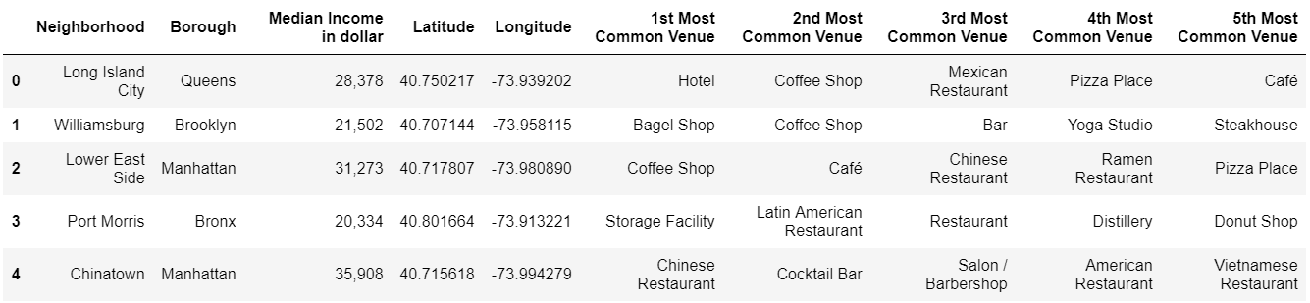
Import and clean data and explore the neighborhood
All data are merged into a dataframe from the mentioned sources
Result:

Slide 7
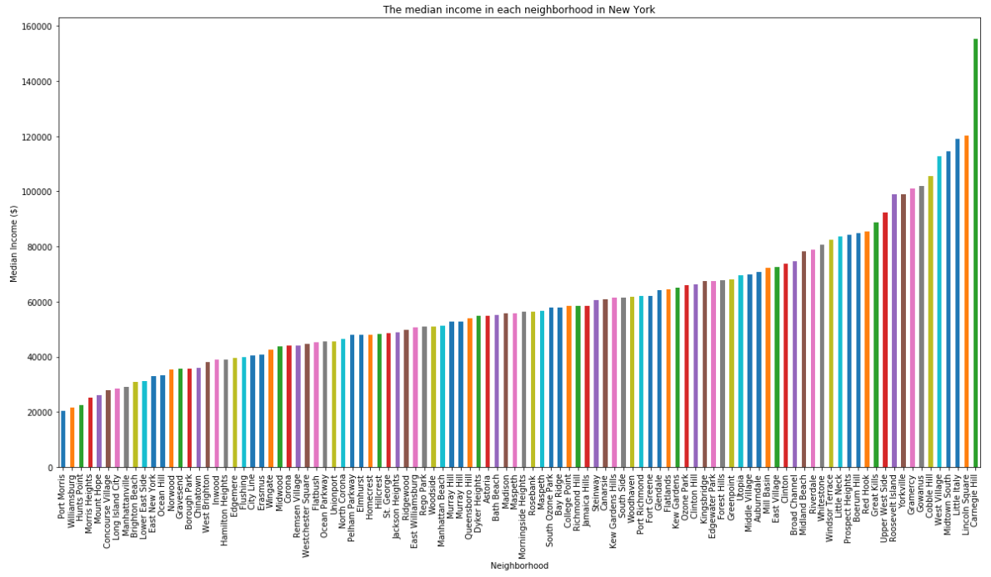
How to divide the group? (1)
Manually seems impossible

Slide 8
How to divide the group? (2)
Use K means clustering on their median income
Result (USD per year):
Low Income (20334 ~ 52696): 12 Neighborhoods
Moderate Income (53836 ~ 85496): 45 Neighborhoods
High Income (88868 ~ 155213): 45 Neighborhoods

Slide 9
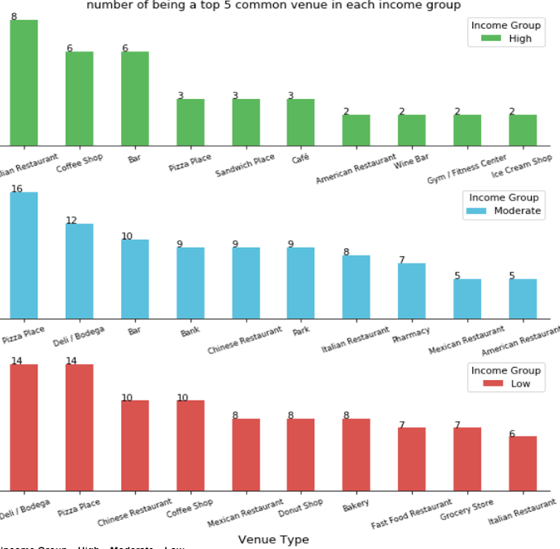
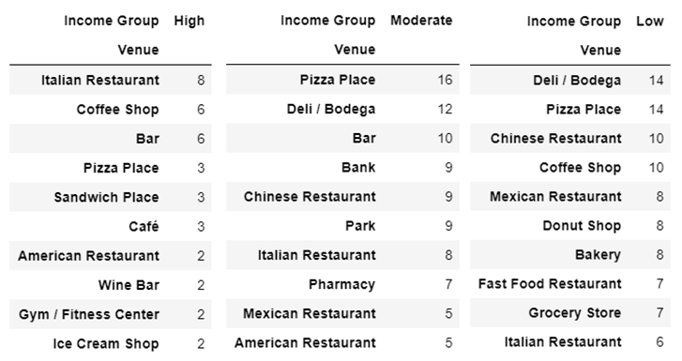
Result – intra-group comparison
Answers the question: ‘what kind of business should one establish in each of the income group’
Outstanding venue in each group:
{High: Italian Restaurant, Moderate: Pizza Place, Low: Deli/ Bodega and Pizza Place}

Slide 10
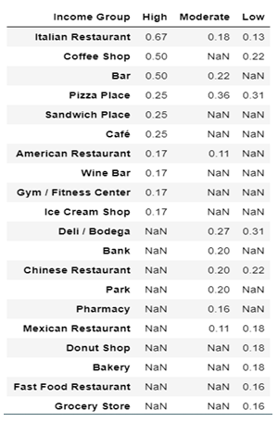
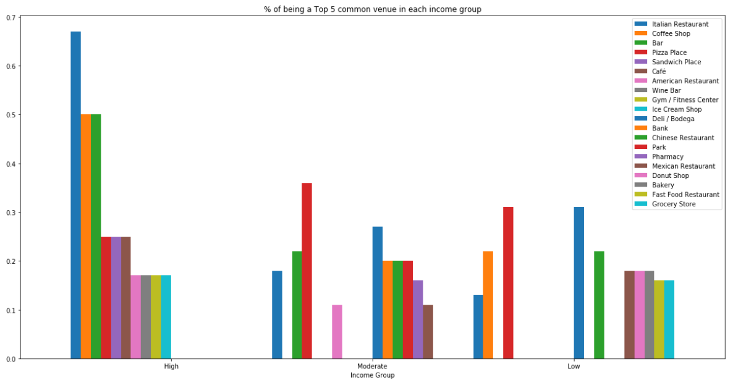
Result – inter-group comparison
Answers the question: ‘which income group one should target’
Formula
A color bar appears once = must do business targeting that group
A color bar appears twice or above = choose group with higher % at first, expand to the second group or the third later

Slide 11
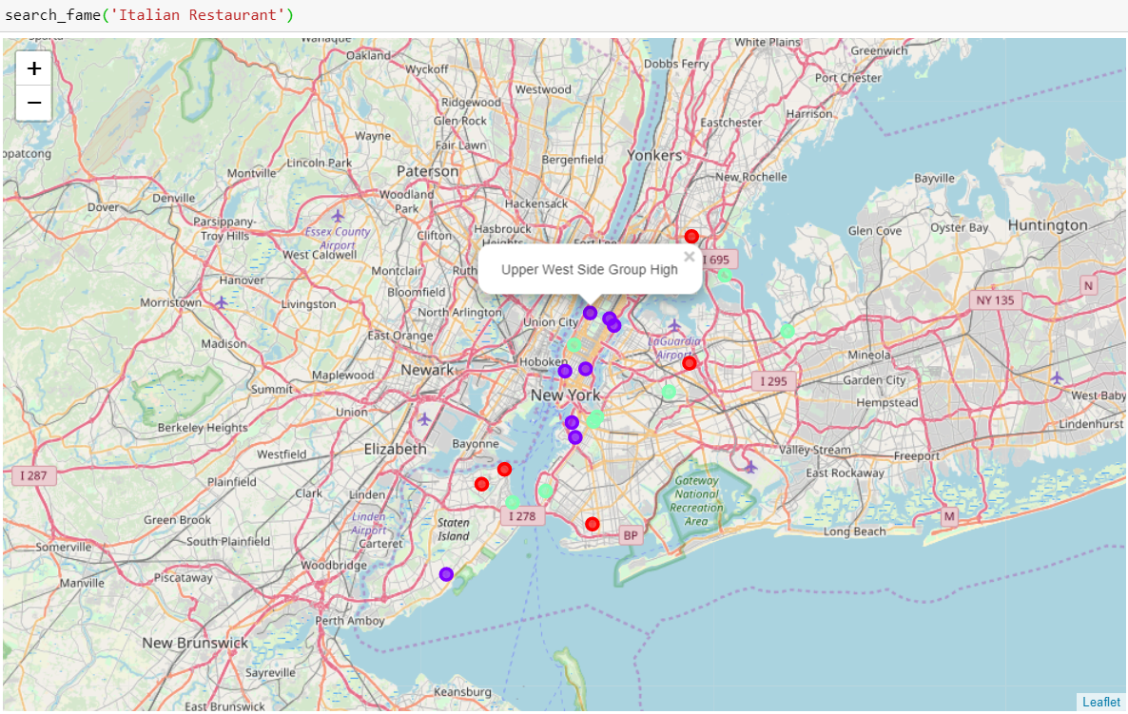
The tool: search_fame(‘venue name’)
show the neighborhood and income group being a top 5 common venue

Slide 12
How to improve?
Enlarge the data set for the high income group
Append the data set for the turnover of all venues
Apply logistic regression for the part of inter-group comparison

Slide 13
Conclusion
Understand the market situation in NYC
Earn insights about the consuming properties of different income groups
Helps entrepreneurs to target the places and groups they should start or expand their businesses

